Slide 1
DJANGO ADMIN
江琳

Slide 2
User model

Slide 3
User Model
Django has a default user model.
User objects are the core of the authentication system.
Only one class of user exists in Django’s authentication framework

Slide 4
User objects
User objects have the following fields:
username | first_name
last_name | email
password | groups
user_permissions | is_staff
is_active | is_superuser
last_login | date_joined

Slide 5

Play with dbshell
(env) $ python manage.py dbshell
SQLite version 3.16.0 2016-11-04 19:09:39Enter ".help" for usage hints.
sqlite> .table
auth_group books_book
auth_group_permissions books_category
auth_permission books_publisher
auth_user django_admin_log
auth_user_groups django_content_type auth_user_user_permissions django_migrations
books_author django_session
auth_user is the default user model

Slide 6
Play with dbshell
The command python manage.py dbshell access the database that define in settings.py.
If the database is PostgreSQL or MySQL, password will be required.
We can execute custom SQL command under this mode.

Slide 7
Custom user model
We can user the User model directly
But if you’re starting a new project, it’s highly recommended to set up a custom user model, even if the default User model is sufficient for you.
You also can add extra fields to the custom user model

Slide 8
Custom user model
Before we custom user model, creating a app named accounts first.
(env) $ python manage.py startapp accounts

Slide 9

Step 1: custom user model
from django.contrib.auth.models import AbstractUser
class User(AbstractUser):
pass
AbstractUser is a full User model, compete with fields, as an abstract class so that you can inherit from it and add your own profile fields and methods.

Slide 10
Step 1: custom user model
from django.db import models
from django.contrib.auth.models import AbstractUser
class User(AbstractUser):
nickname = models.CharField(max_length=100)

Slide 11

Step2: settings
Open settings.py and add :
AUTH_USER_MODEL = 'accounts.User'

Slide 12
Step 3: migrations
$ python manage.py makemigrations accounts
$ python manage.py migrate

Slide 13
tips
If faill to migrate:
Run: rm –f db.sqlite3 to delete db.sqlite3
Then migrate

Slide 14
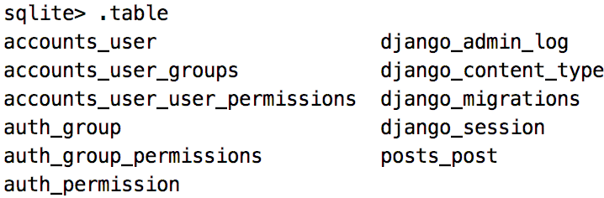
custom User Model
There is no auth_user table any more, because Django allows one user model only.

Slide 15
custom User Model
(env) $ python manage.py dbshell
SQLite version 3.16.0 2016-11-04 19:09:39
Enter ".help" for usage hints.
sqlite> .table
accounts_user books_book accounts_user_groups books_category accounts_user_user_permissions books_publisher auth_group django_admin_log auth_group_permissions django_content_type auth_permission django_migrations books_author django_session
There is no auth_user table any more, because Django allows one user model only.

Slide 16
Django admin

Slide 17
Philosophy
Generating admin sites for your staff or clients to add, change, and delete content is tedious work that doesn’t require much creativity. For that reason, Django entirely automates creation of admin interfaces for models.
The admin isn’t intended to be used by site visitors. It’s for site managers.

Slide 18
Admin site
python manage.py runserver
Open the link: http://127.0.0.1/admin

Slide 19
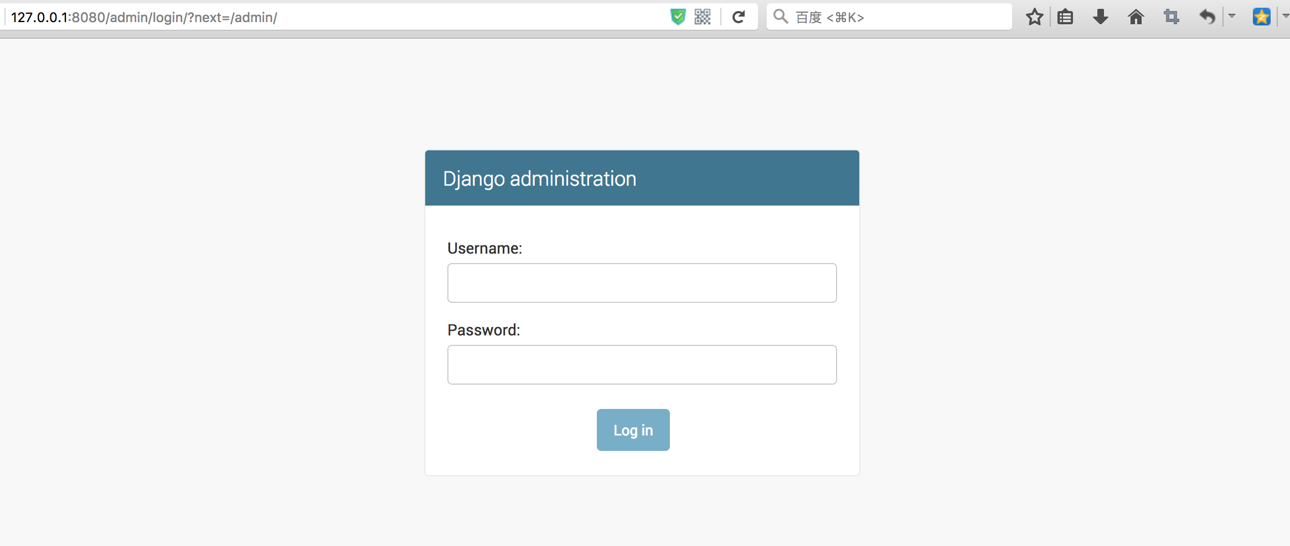
Admin site

Slide 20
Creating superuser
First of all, we need to create a user who can login to the admin site.
(env) $ python manage.py createsuperuser
Username: admin
Email address: admin@admin.com
Password:
Password (again):
Superuser created successfully.

Slide 21
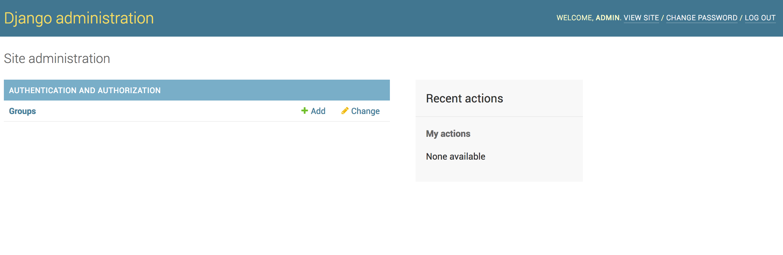
Admin site
Now we can login to the admin site

Slide 22
Admin site
Nothing except group. Where is post model and user model?
We need tell tell the admin that who have an admin interface.

Slide 23
Admin site
open the accounts/admin.py and code below:
from django.contrib import admin
from .models import User
admin.site.register(User)

Slide 24
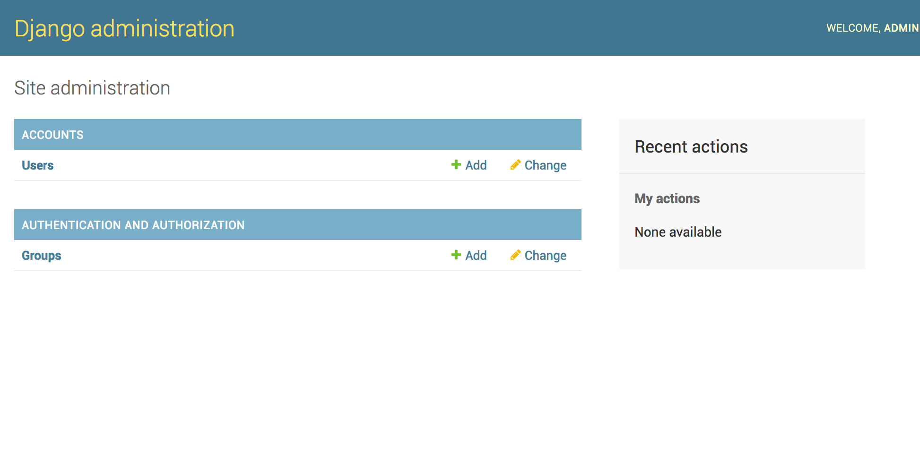
Admin site
Now, we can add new user and change existing user in admin site

Slide 25
Admin site
Open books/admin.py then code below:
from django.contrib import admin
from .models import Publisher, Author, Category, Book
admin.site.register(Publisher)
admin.site.register(Author)
admin.site.register(Category)
admin.site.register(Book)

Slide 26

Modeladmin
The ModelAdmin class is the representation of a model in the admin interface.
from django.contrib import admin
from .models import User
class UserAdmin(admin.ModelAdmin):
pass
admin.site.register(User, UserAdmin)

Slide 27

Modeladmin
from django.contrib import admin
from .models import User
class UserAdmin(admin.ModelAdmin):
fields = ('username', 'is_superuser', 'password')
list_display = ('username', 'is_superuser')
admin.site.register(User, UserAdmin)

Slide 28
Modeladmin
fields option to make simple layout changes in the forms on the “add” and “change” pages
list_display to control which fields are displayed on the change list page of the admin.

Slide 29
The register decorator
from django.contrib import admin
from .models import User
@admin.register(User)
class UserAdmin(admin.ModelAdmin):
fields = ('username', 'is_superuser', 'password')
list_display = ('username', 'is_superuser')
The register decorator can instead of admin.site.reigster

Slide 30
Questions?

